Slide 1
Discrete Structures
Instructor: Zubaria Asma
Course Code: CS-335
Credit Hours: 3(3-0)
Lecture # 23

Slide 2
INTRODUCTION
TO
GRAPHS

Slide 3
INTRODUCTION TO GRAPHS
Graph theory plays an important role in several areas of computer science such as:
Switching theory and logical design
Artificial intelligence
Formal languages
Computer graphics
Operating systems
Compiler writing
Information organization and retrieval.

Slide 4
GRAPH:
A graph is a non-empty set of points called vertices and a set of line segments joining
pairs of vertices called edges.
Formally, a graph G consists of two finite sets:
(i) A set V=V(G) of vertices (or points or nodes)
(ii)A set E=E(G) of edges; where each edge corresponds to a pair of vertices.

Slide 5
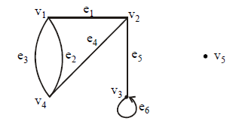
GRAPH:
The graph G with
V(G) = {v1, v2, v3, v4, v5} and
E(G) = {e1, e2, e3, e4, e5, e6}

Slide 6
SOME TERMINOLOGY:
An edge connects either one or two vertices called its endpoints (edge e1 connects vertices v1 and v2 described as {v1, v2} i.e v1 and v2 are the endpoints of an edge e1).
An edge with just one endpoint is called a loop. Thus a loop is an edge that connects a vertex to itself (e.g., edge e6 makes a loop as it has only one endpoint v3).
Two vertices that are connected by an edge are called adjacent; and a vertex that is an endpoint of a loop is said to be adjacent to itself.

Slide 7
SOME TERMINOLOGY:
An edge is said to be incident on each of its endpoints(i.e. e1 is incident on v1 and v2 ).
A vertex on which no edges are incident is called isolated (e.g., v5)
Two distinct edges with the same set of end points are said to be parallel (i.e. e2 & e3).

Slide 8
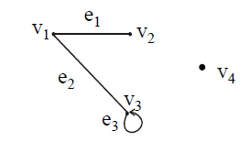
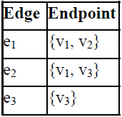
EXAMPLE:
Define the following graph formally by specifying its vertex set, its edge set, and a table giving the edge endpoint function.
SOLUTION:
Vertex Set = {v1, v2, v3, v4}
Edge Set = {e1, e2, e3}
Edge - endpoint function is:

Slide 9
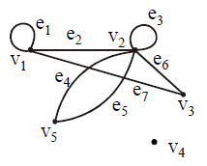
EXAMPLE:
For the graph shown below
(i) find all edges that are incident on v1;
(ii)find all vertices that are adjacent to v3;
(iii)find all loops;
(iv)find all parallel edges;
(v)find all isolated vertices;

Slide 10
SOLUTION:
(i) v1 is incident with edges e1, e2 and e7
(ii) vertices adjacent to v3 are v1 and v2
(iii) loops are e1 and e3
(iv) only edges e4 and e5 are parallel
(v) The only isolated vertex is v4 in this Graph.

Slide 11
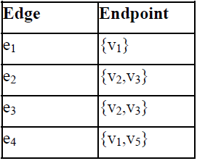
DRAWING PICTURE FOR A GRAPH:
Draw picture of Graph H having vertex set {v1, v2, v3, v4, v5} and edge set {e1, e2, e3, e4} with edge endpoint function

Slide 12
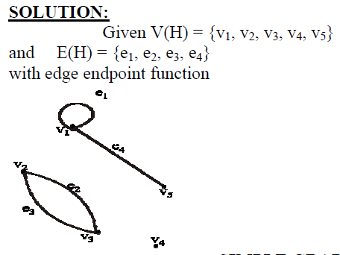
DRAWING PICTURE FOR A GRAPH:

Slide 13
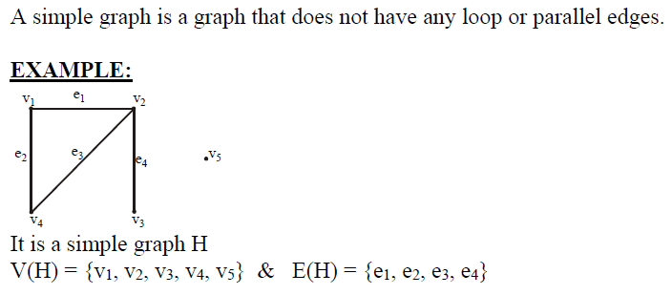
SIMPLE GRAPH:

Slide 14
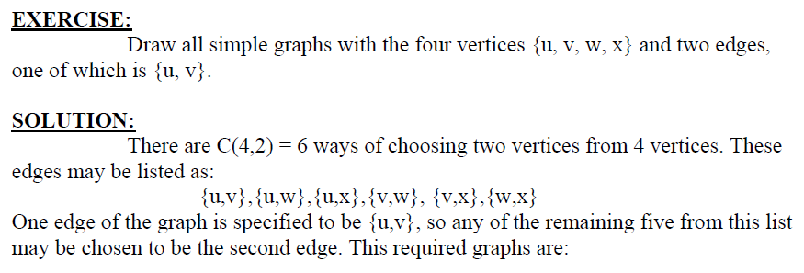
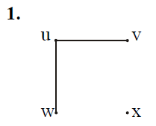
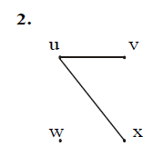
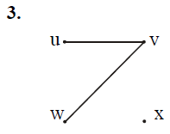
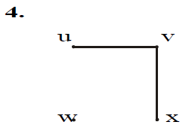
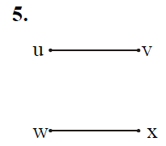

Slide 15
DEGREE OF A VERTEX:
Let G be a graph and v a vertex of G. The degree of v, denoted deg(v), equals the number of edges that are incident on v, with an edge that is a loop counted twice.
Note:
(i)The total degree of G is the sum of the degrees of all the vertices of G.
(ii) The degree of a loop is counted twice

Slide 16
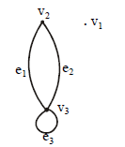
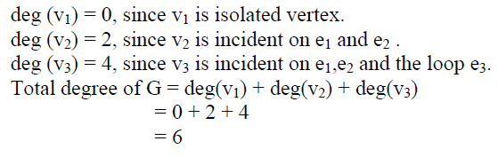
DEGREE OF A VERTEX:
EXAMPLE:

Slide 17
COMPLETE GRAPH:
A complete graph on n vertices is a simple graph in which each vertex is connected to every other vertex and is denoted by Kn (Kn means that there are n vertices).
The following are complete graphs K1, K2,K3, K4 and K5.

Slide 18

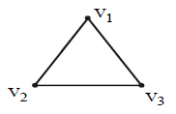

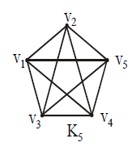
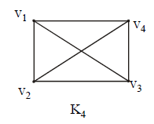
COMPLETE GRAPH:

Slide 19
REGULAR GRAPH:
A graph G is regular of degree k or k-regular if every vertex of G has degree k.
In other words, a graph is regular if every vertex has the same degree.

Slide 20
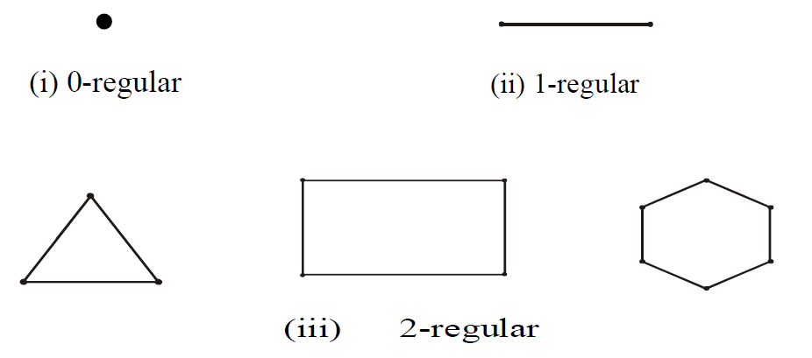
REGULAR GRAPH:

Slide 21
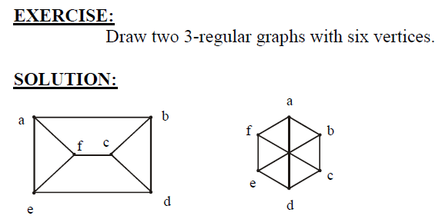

Slide 22

THANK YOU

